Slide 1
Experiencias Internacionales sobre Negociación Colectiva, Condiciones de Trabajo y Productividad. El caso de Alemania
Gerhard Bosch
International Labour Organization
Web-seminar June 15, 2022

Slide 2
Structure of presentation
I: The legal framework of IR and the actors (trade unions, employer‘s organizations and the state)
II: Coverage by collective agreements
II: Regulation of working conditions and productivity

Slide 3
I.1 The legal Framework: Principal characteristics of collective bargaining (CB) in Germany
Key features | 2000 | 2017
Actors | Trade unions, individual employers and employers’ associations
Bargaining levels | Dominance of sector level, increasing importance of company level
Favourability principle | Company CA’s cannot undercut sectoral CA’s, increasingly opening clauses in sectoral CA’s
After-effect | Unlimited after-effect until it is replaced by a new CA (not for newly employed)
Extension mechanism | Extension with the agreement of the national ‘Bargaining Commission’ if CA covers 50%+ of employees in the respective bargaining area | Since 2015 extension possible if in public interest; extension of minimum working conditions agreed by the social partners in an industry by the Ministry of Labour
Quelle/ Source:

Slide 4
I.2 The Actors: Trade Unions (TU)
No legal criteria for representativeness, TU must be „powerful“
Only sectoral unions, no company unions in Germany, company bargaining also by sectoral unions
  DGB (German Trade Union Federation 6 Mil. members
        IG Metall (metal industry) 2.274.000
        Ver.di (services) 2.039.000
        IGBCE (chemical and engery workers) 651.000
        IG BAU (construction, cleaning, agriculture) 273 000
        GEW (teachers) 281.000
        NGG (food, restaurants, hotels) 204.000
        EVG (railways, transport) 197.000
        GDP (police) 177.000
  Deutscher Beamtenbund (DBB)(mainly civil servants) 1.294.000
  Christian Trade Unions 280 000
  Non affiliated Unions 270 000
Trade union density: dropped from 25.9% 1998 to 16,5% 2018

Slide 5
I.3 The Actors: Employer Associations (EA‘s)
Most EA‘s in the private sector member of the „Confederation of German Employers’ Associations’ (Bundesvereinigung der Deutschen Arbeitgeberverbände’, BDA).
  Industry EA’s have the mandate to negotiate - BDA no mandate to negotiate – but coordinates CB
Also loss of organizational power of EA‘s
  Employer density dropped from 73% in 1988 to 43% in 2014, in the public sector 100% density
  EA‘s try to retain members by offering membership without the obligation to comply with CA‘s (so-called ‘Ohne Tarifbindung’, OT status).

Slide 6
I.4 The Actors: The state
Traditionally no state intervention in CB
  Intervention at the demand of social partners: extension of CA‘s
  Since 1996: Industry speficic minimum wages extended to protect CA‘s against wage dumping through foreign posted workers
  Since 2015 National Statutory Minimum Wage
Strengthening of institutional of power of employees through legally regulated codetermination at plant and company level
    Strong information and cotermination rights of works councils, but no right to strike
    174,000 German works councillors elected on a voter turnout of 80% - mostly in big and medium sized companies: high trust
    Around 8,400 WC’s released from all work
    80% of works councillors union members
    Regular training of works councillors in trade union training centers paid by employers
    Work councils crucial for the implementation, specification and the enforcement of CA’s
    Strong interplay between industry and company level

Slide 7
II.1 Coverage by CA‘s
Substantial decline of coverage by CA‘s: From 85% in 1990 to 51% in 2020 – Dualization of the German labor market
Reasons: Privatization, new business models, outsourcing, precarious forms of work, tertiarisation, globalization, policy changes (dere-gulation, opposition of employer‘s organization to extension of CA‘s)
Coverage by collective agreements in East- and West-Germany 1998 - 2020

Slide 8
II.2 Coverage by CA‘s
High sectoral differences
Coverage by sectors 2018

Slide 9
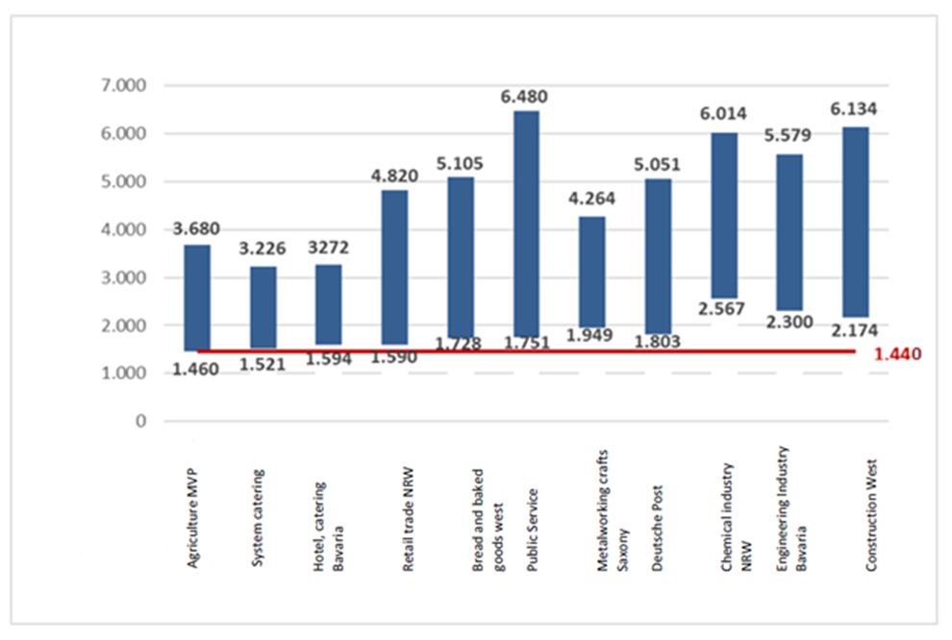
III. 1 Content of CA‘s: Wages
Range of collectively agreed wages and the MW (€ /month) 2018

Slide 10
III. 2 Content of CA‘s: Weekly working hours
Average collectively agreed working hours, 1984-2020

Slide 11
III. 3 Working time flexibility
In exchange for w-time reduction: Flexible distribution of working hours over the year or the product cycle - with high producitivity and cost effects (less overtime)
Temporary reduction of standard working hrs in a crisis possible to retain skilled workers: Examples:
    Banking from 39 to 31 hrs/week/ Metall industry Baden-Württemberg 35 to 30 hrs
Brand new: Working time options for employees: Money or time? Motivation: Attracting and retaining skilled workers
  German Railways: 5,2% wage increase or 2 hrs reduction of weekly working hrs or 12 days off
  Metall industry: Yearly bonus of 27,5% of monthly pay or 8 days off per year for employees in shift work, with children under 8 years or with care obligations
  High preferences for shorter working hrs instead wage increases

Slide 12
III. 4 Modernization of classification systems
Example Metall industry: Before 2002: Four job classifications: for (1) blue-collar workers, (2) masters, (3) technical employees, (4) commercial employees
Replaced by a joint classification system based on 5 criteria: 1) Required skills, (2) Prior work experience, (3) Scope for decisions, (4) Cooperation, (5) Management
    Encouragement of work in teams and flat hierarchies
    Blue-collar workers can move up the wage scale easier Implementation over six years, no wage cuts for „loosers“
Similar reforms on other industries where social partners are strong, but not in industries with low coverage by CA‘s like in retail or transport
Effect: flat hierarchies, modern work organization with higher productivity in whole industries: no „house to-house fighting“ like with decentralized collective bargaining

Slide 13
III. 5 Modernization of vocational training
61% of German employees have vocational training qualifications
Around 4,5 % of the employees are apprentices
Training in around 350 national white and blue collar occupations
Training duration 2 – 4 years, 3 days a week in the company, 2 days in vocational schools
Basic idea: increase of functional flexibility through broad training which helps to cope with changing work environment
Social partners decide in the main committee of the German Federal Institute of Vocational Training on the basic standards of new or modernized occupations (occupational title, duration of training, training programme)
National and sectoral training alliances and CA’s and plant agreements on vocational training (levy systems, obligations to train etc.)

Slide 14
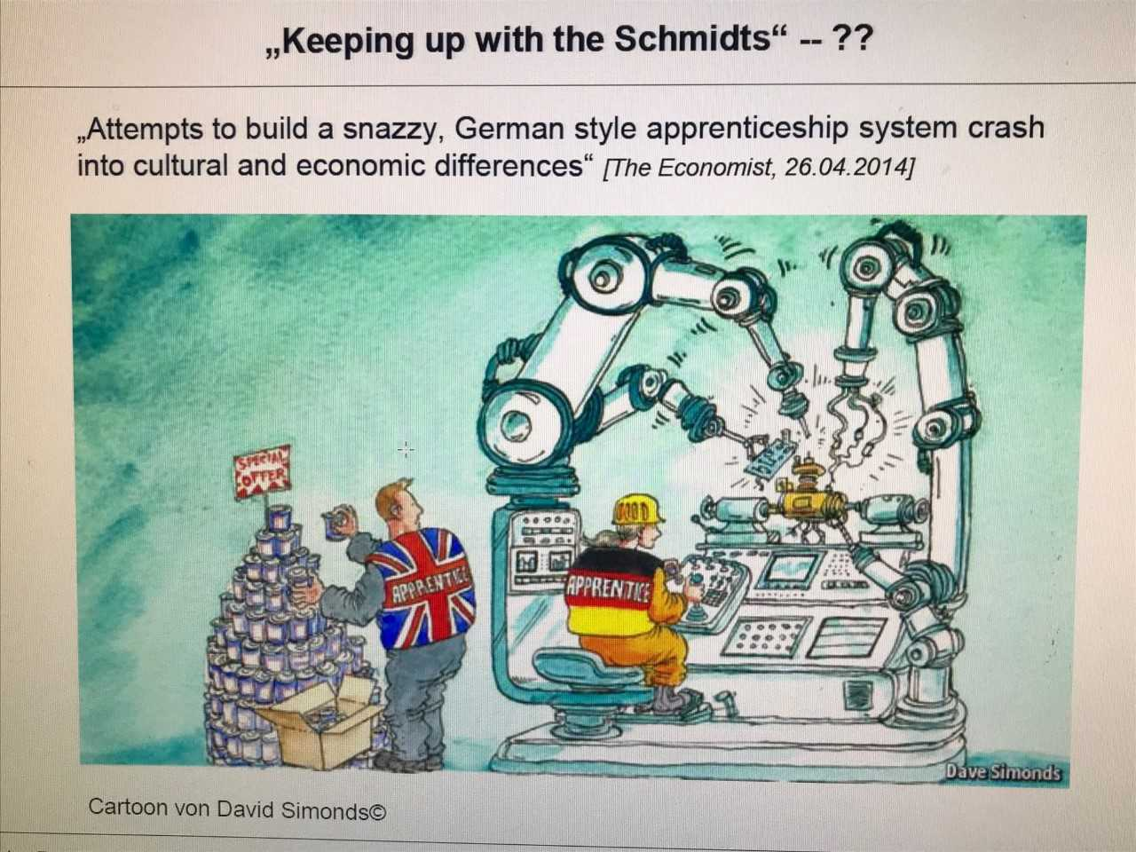

Slide 15
III. 6 Responses to the great recession and the Covid-19 crisis
German job miracle in the Great Recession: Reduction of GDP by 4,9% but no decrease of employment and increase of unemployment
Work sharing „dismissal of hours not employees“ by cut of overtime, use of credit hrs from wt-accounts, state subsidized short-time work, temporary reduction of agreed wtime
„Training alliances“ at national, sectoral, local and company level – recruitment of 564 000 new apprentices to replace the retirees
Main effect: maintaining production capacity in the core industries to support a fast recovery after the crisis

Slide 16
III. 7 Responses to the great recession and the Covid-19 crisis
Percentage of fall in total labour input due to fall in working hours per employee in the EU and the US 2008–2009

Slide 17
III.8 Number of employees in short-time in million in the Covid crisis

Slide 18
III.9: Decreasing importance of performance related pay
Example: engeneering industry 2008 – 2020
Research shows that bonuses mostly do not have permanent productivity effects
Source:: Gesamtmetall Zahlenheft 2021

Slide 19
III. 10 Impact of Works Councils on working conditions
    WC’s elected in almost all large companies, but their share decreases with size of company
      Act as “Labor inspector’s” – enforce CA’s and labour laws
      Protect employees against unfair treatment
      Higher job security (internal transfer instead of dismissals), better employability (more training in companies with WoC), more investment in OHS
      Strategic Co-Management: Discuss business strategies, investment plans, industry 4.0, HR-Policies ……
      Research shows: Positive impact of WC’s on the performance of the companies – same result for codetermination in supervisory boards
      High acceptance in many employers but also WC busting increasing

Slide 20
III.11 Working conditions in the dual German labor market much better in companies with an CA
 | Covered | Not-covered | Difference
Average hourly wage
Total | 22.04 € | 16,66 € | 24,4%
Manufacturing | 26,52 € | 17,58 € | 33,7%
Retail trade | 18,75 € | 15,87 € | 15,4 %
Health, care, social work | 20,98 € | 16,11 € | 23,2 %
Holiday Bonus | 73 % | 35 % | 38 %points
Actual weekly working hrs | 38,6 hrs | 39,5 hrs | O,9 hrs

Slide 21
Conclusions
Decreasing coverage by collective agreements – dualization of labor market
Industries with weak social partners – often outdated CA‘s
In industries with strong social partners: innovative new agreements – good interplay betwenn industry and company level
Focus not on performance related payment but on trustful cooperation in the modernization of the companies – with a focus on training, retraining, working time flexibility and work organization

